Slide 1

Facial Emotion Recognition
Presented by Alan Wang, Amy Tang, Isaac No, Joy Richardson, Philip Huang, Tim Chen

Slide 2
Background
Facial Recognition is one of the many topics within the field of artificial technology, where it aims to achieve in identifying a person using their face.
Facial emotion recognition is a specialized topic that narrows down identifying further by analyzing the physiological features of an individual.
We aim to explore differences in classifying facial expressions through the models we learned in this course, primarily focusing on the process of implementing them and analyzing their achieved results.

Slide 3
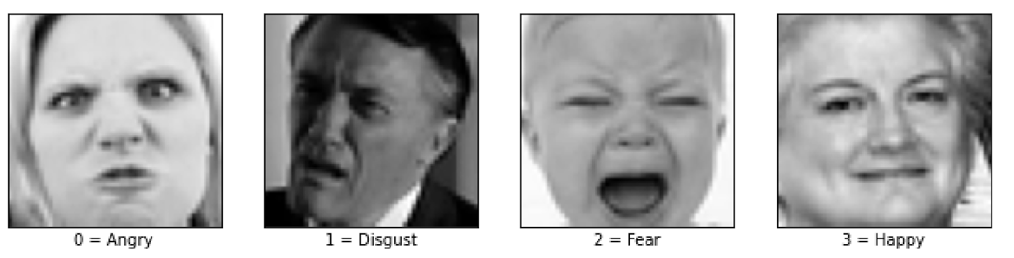
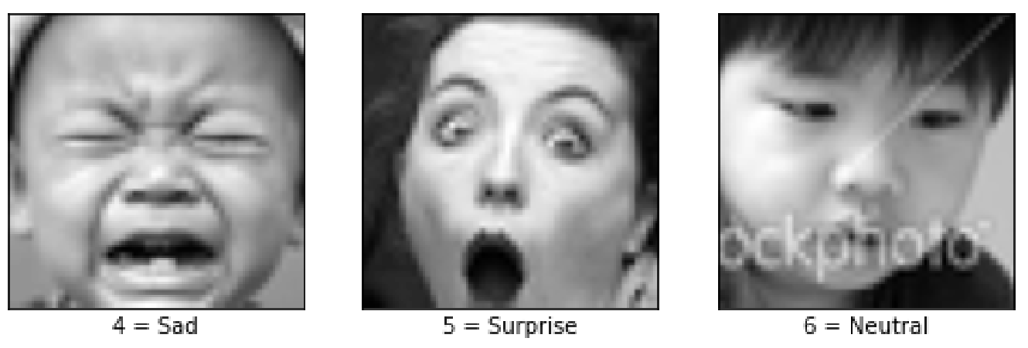
Dataset and EDA

Slide 4
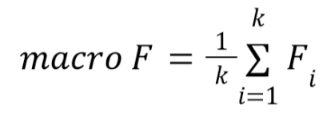
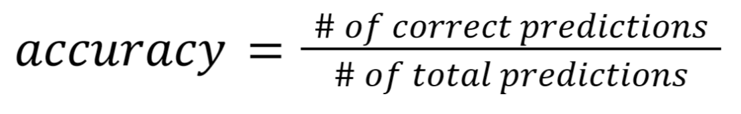
Preprocessing
Notes:
per-class F scores

Slide 5
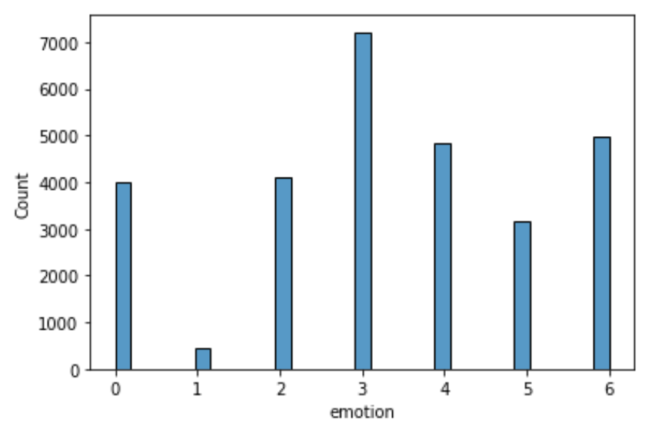
Preprocessing
Imbalance Dataset
⬇ ⬇ ⬇
Subsample or Oversample so that each class has 3,000 instances in training set

Slide 6
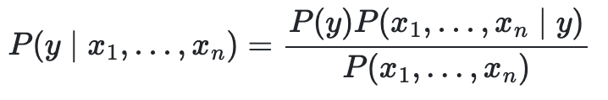
Naïve Bayes Classifier
Naïve Bayes uses the Bayes classifier to perform supervised learning
The Bayes Classifier is a probabilistic model of the form
The naive assumption of Bayes is based on strong independence between the features x1,...,xn. It does not take into account the weight of one variable over another.
Training accuracy of 23% and validation and test accuracy at 20 and 21%, respectively
Low values in confusion matrix except 0.61 for predicting surprise
Notes:
Naive bayes runs on two main premises - covariances are 0 and no variable has more importance than another

Slide 7
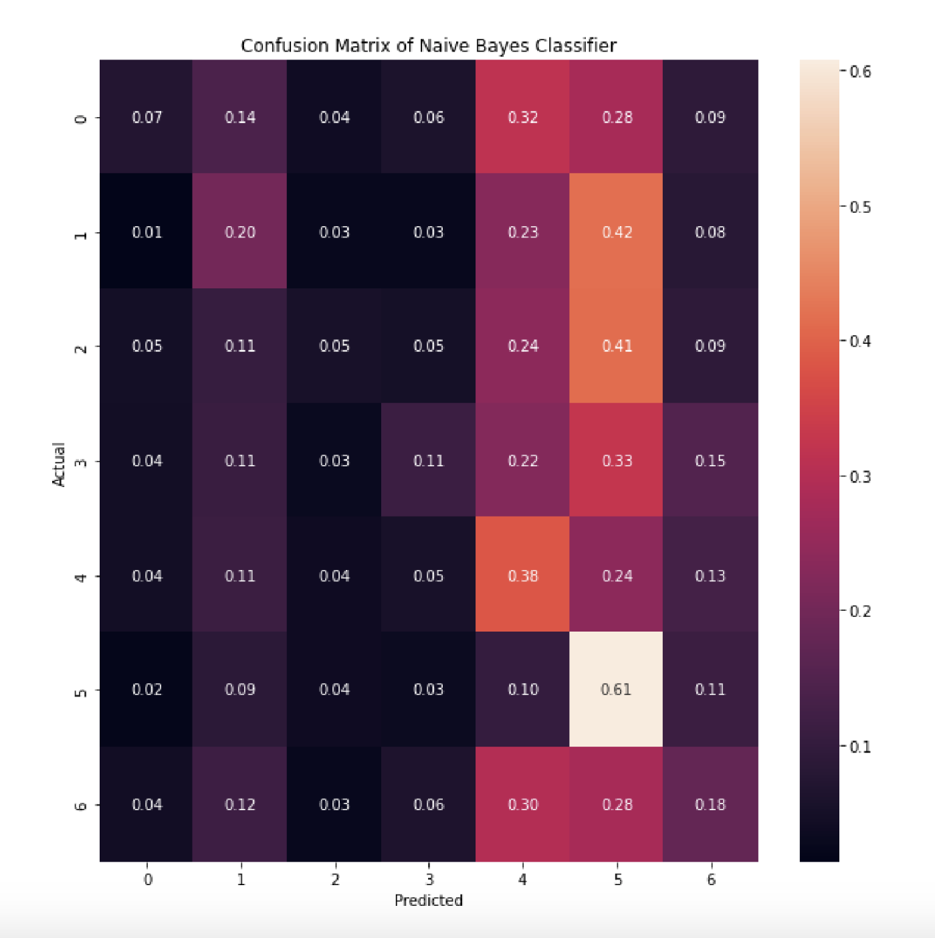

Slide 8
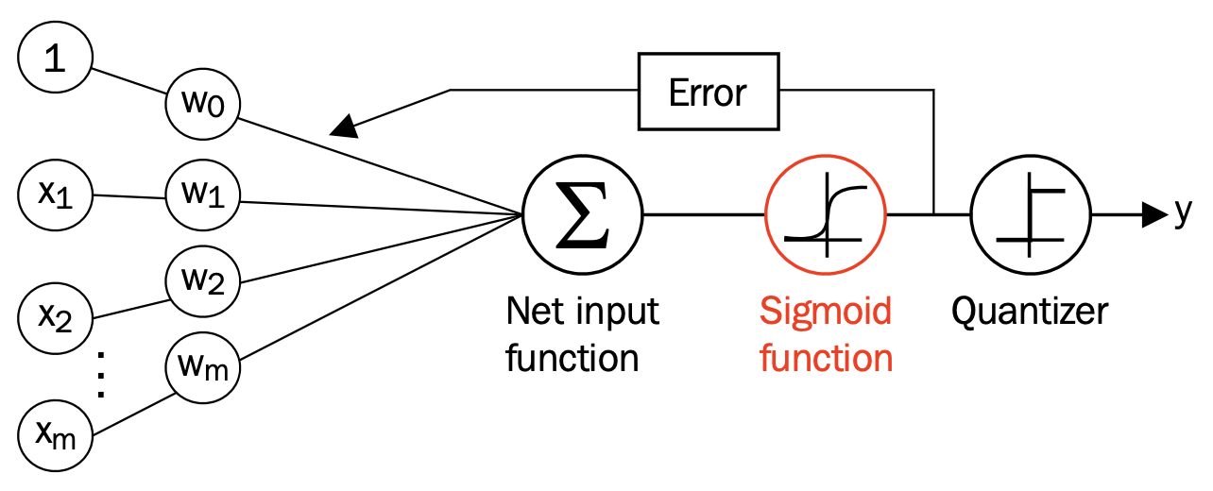
Logistic Regression
Linear model for classification
Probabilistic Discriminative Models
Simple to Implement even without libraries

Slide 9
K-Means + Logistic Regression
Clustering: dimension reduction as a preprocessing step
Surprisingly, result is not good
Possible Reasons:
K-means doesn’t work well on emotion pre-clustering
Logistic regression does poorly on non-linear data

Slide 10
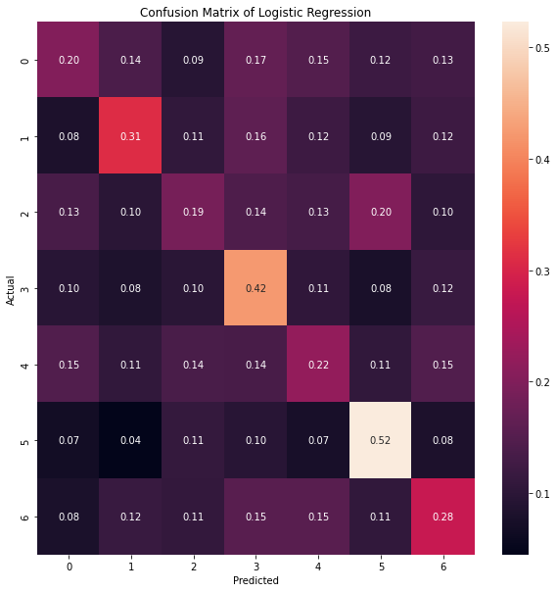
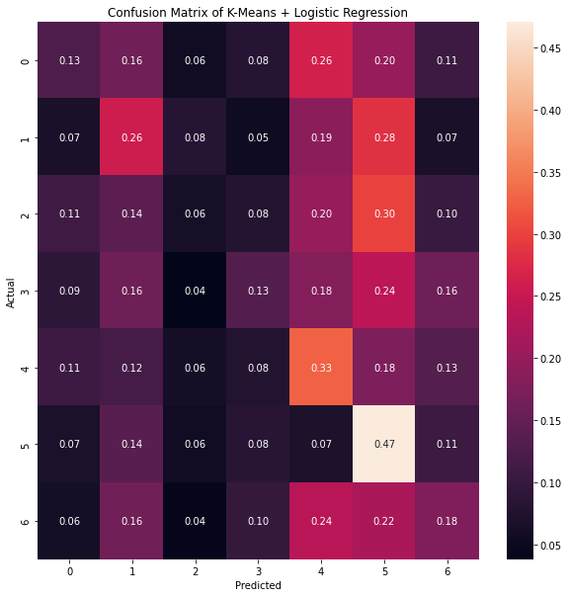

Slide 11
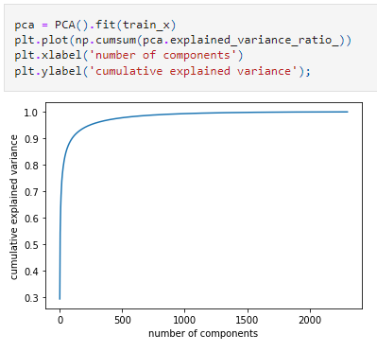
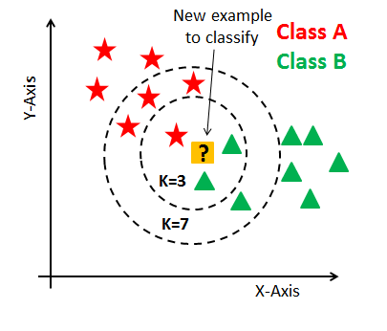
K-Nearest Neighbors with PCA + CV
Notes:
We use pca since there are too many features, will take too long computationally

Slide 12
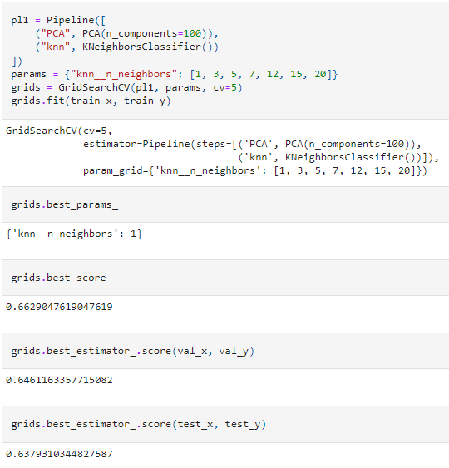
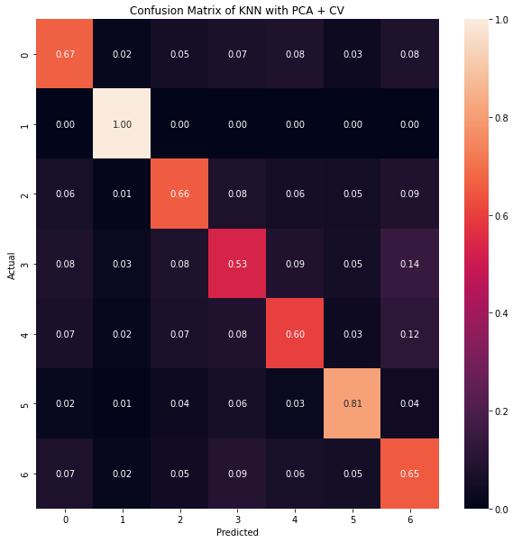

Slide 13
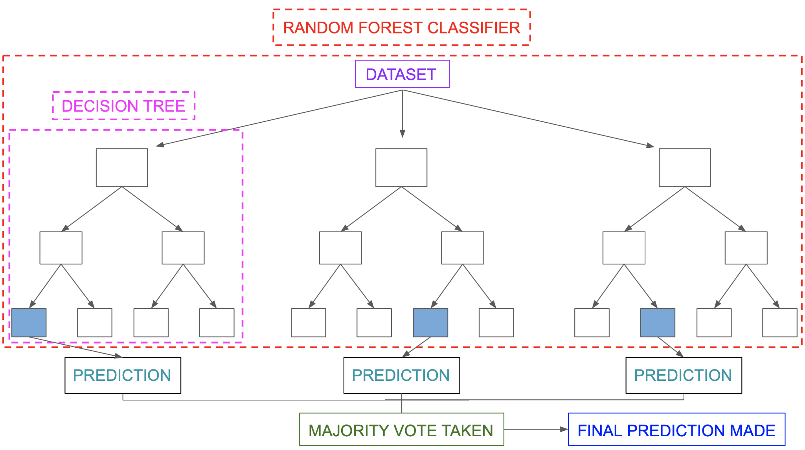
Random Forest
Random forest is a classification method which consists of a large number of individual decision trees that operate as an ensemble.
Each individual tree in the random forest spits out a class prediction and the class with the most votes becomes our model’s prediction
Notes:
Training Accuracy 0.401
Validation 0.287
Test 0.281

Slide 14
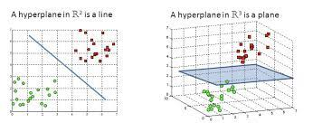
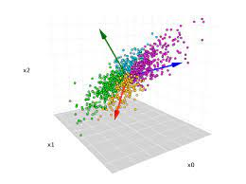
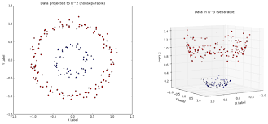
Support Vector Machine with PCA

Slide 15
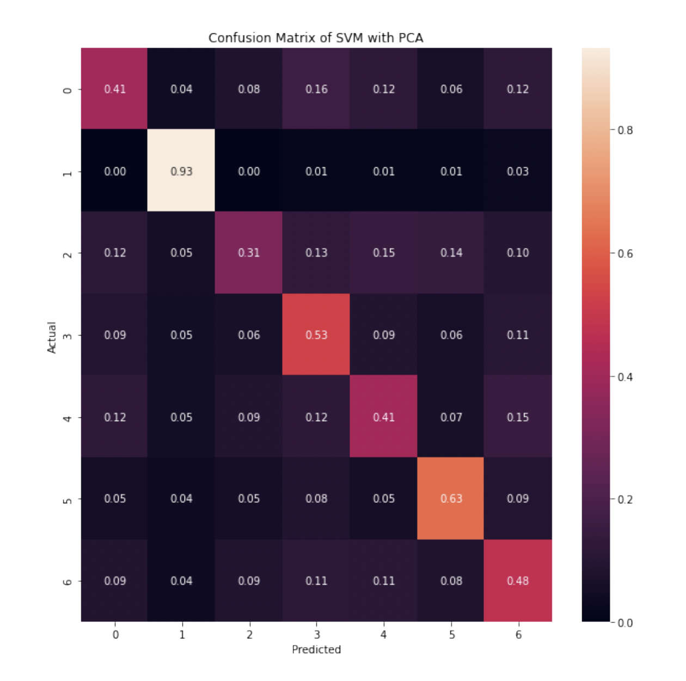
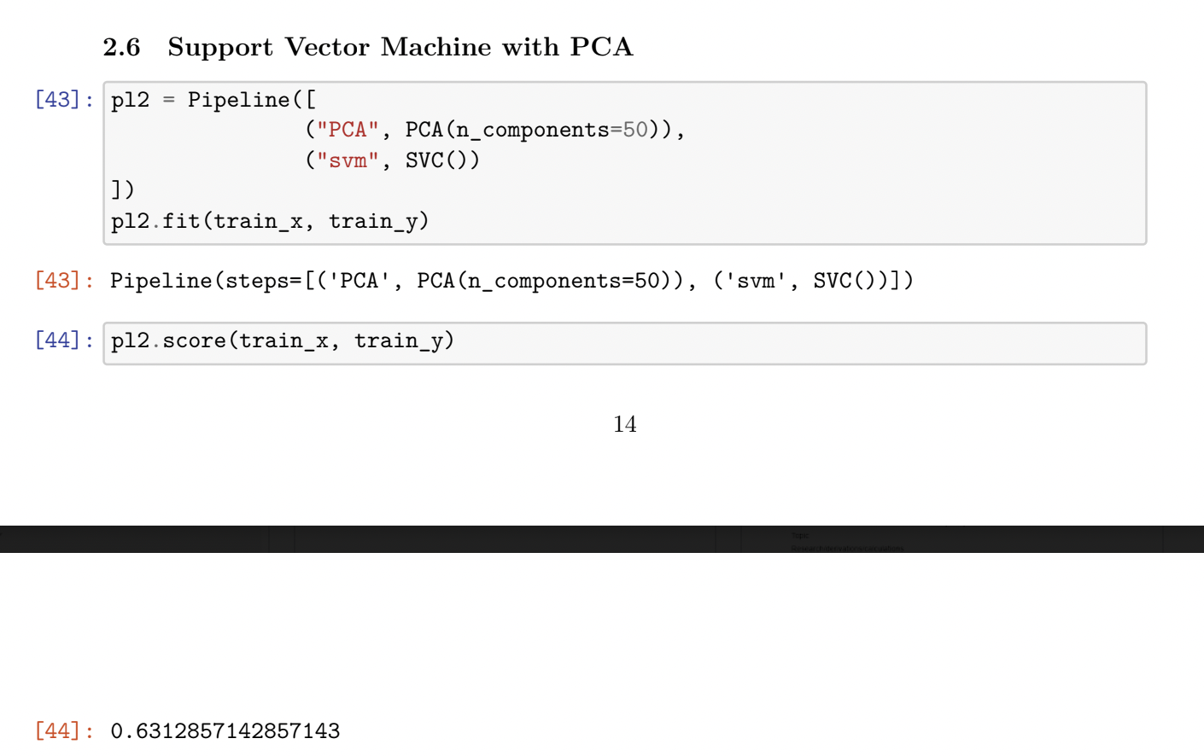
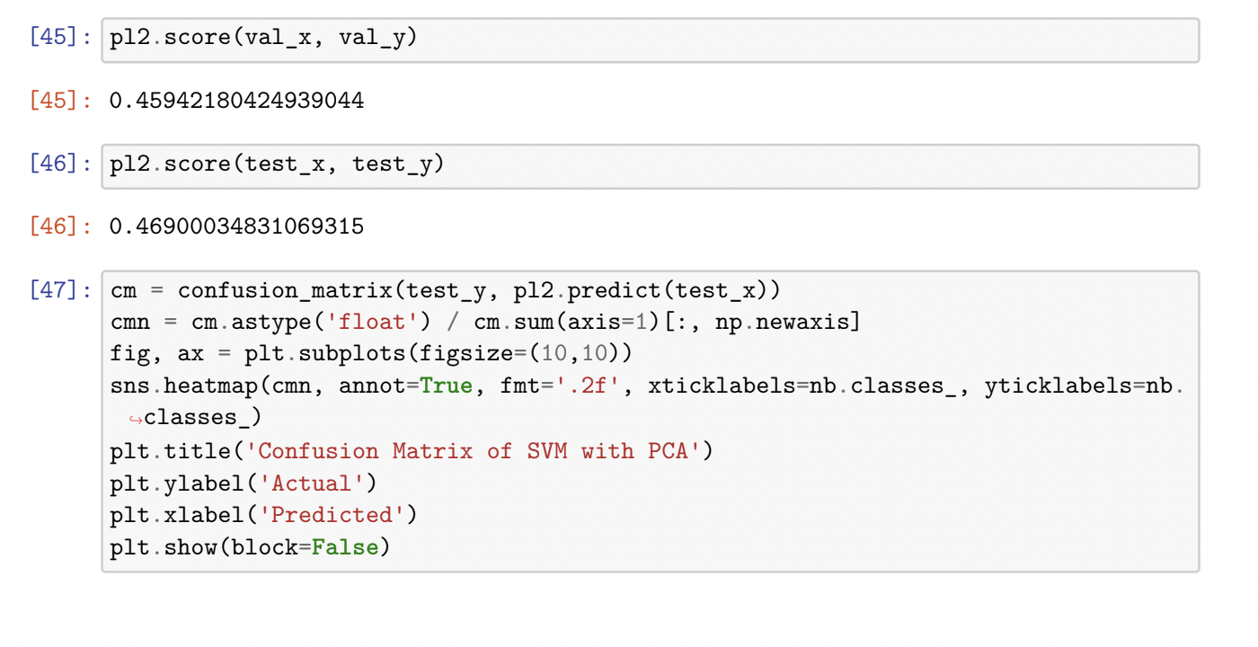

Slide 16
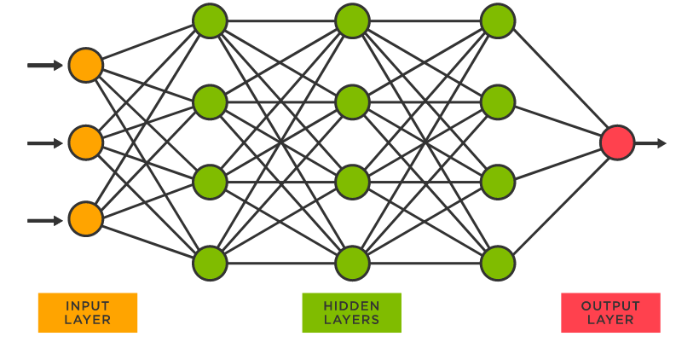
Artificial Neural Network
Input later, hidden layers, and output layer (7 nodes in our case)
Weights and biases
Activation function (sigmoid, ReLU, etc.)
Backpropagation and (stochastic) gradient descent to find the optimal weights and biases that minimize the cost function
Notes:
Miles chen slides

Slide 17
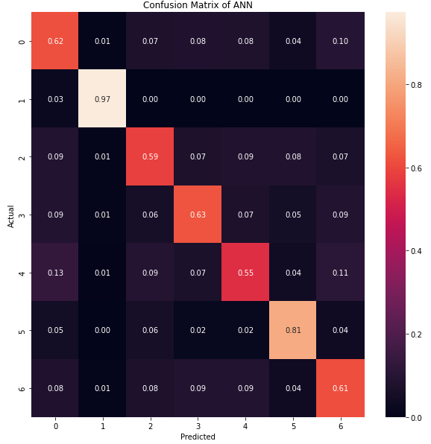
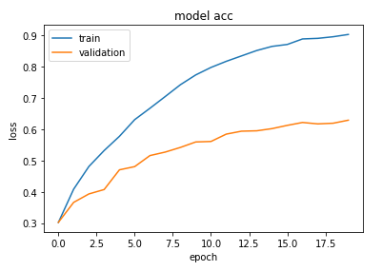
90.33% training accuracy
62.90% validation accuracy
62.87% test accuracy

Slide 18


Convolutional Neural Network

Slide 19
Convolutional Neural Network
Cats have tail but humans don’t.
Cats have hair all over the body but human only have hair on the head.
…
In the brain, we see features first. Lines, curves, shape…
How can we quantify this using mathematics?
Convolution!

Slide 20
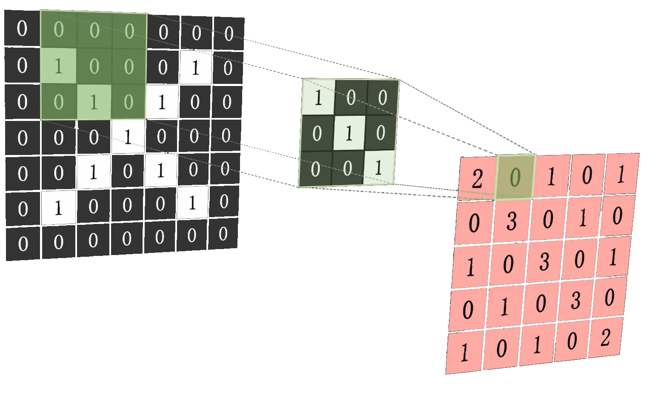
Convolutional Neural Network
Picture of an “X”, binary, 7 * 7
We want to extract the feature
“a line goes from top-left to button-right”, or a diagonal
Use a convolution kernel
3 by 3 Identity Matrix
Do Matrix Dot Product
The greater the number is in the resulting 5 * 5 matrix, the “more” the feature exists in the original picture

Slide 21
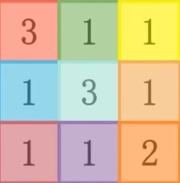
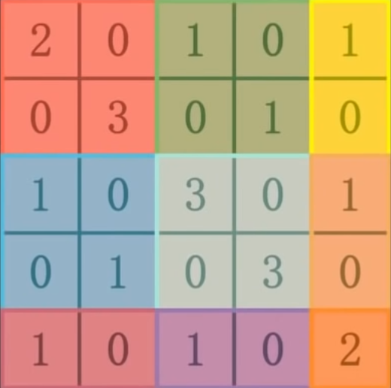
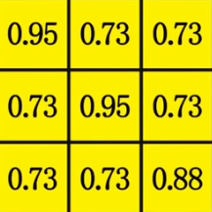
Convolutional Neural Network
Pooling
Take the maximum value of each section
Maintains feature, reduces size
Activation
Apply sigmoid function
Probability of having this feature

Slide 22
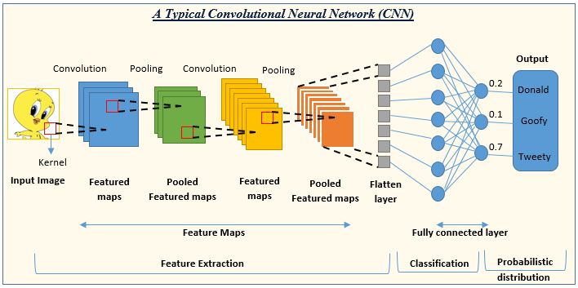
Convolutional Neural Network

Slide 23
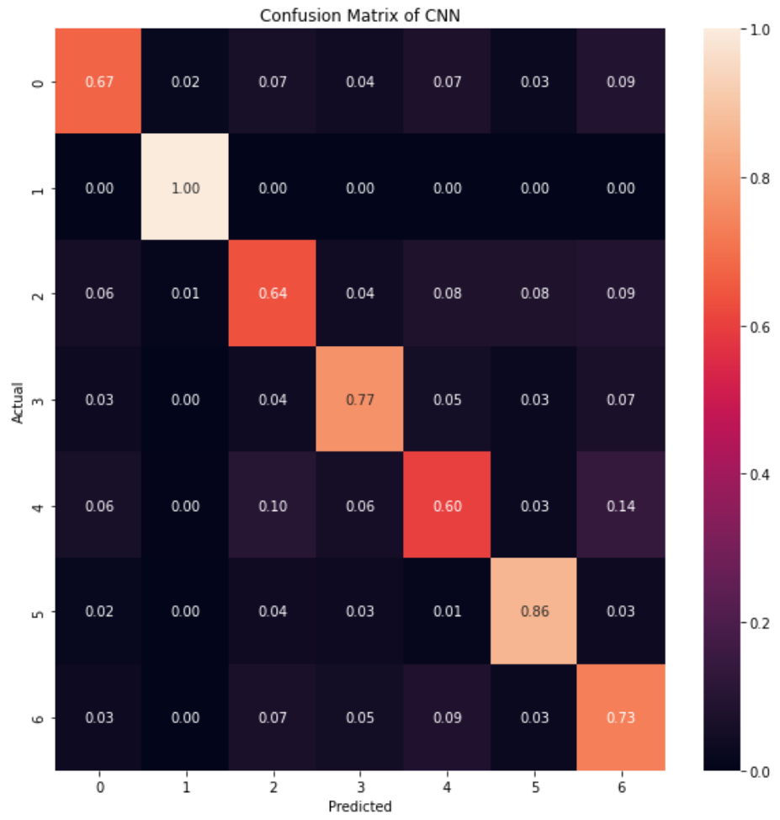
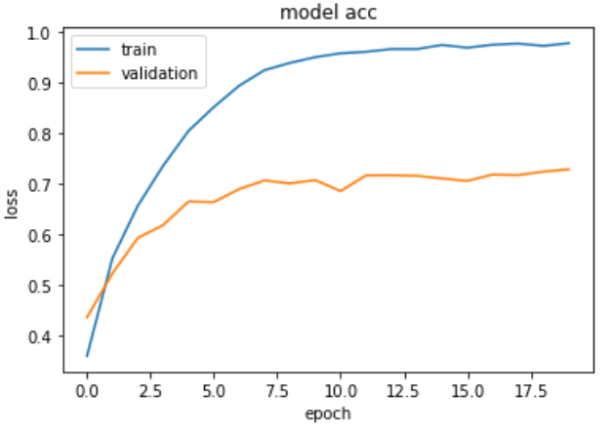
Convolutional Neural Network

Slide 24
Table of Results
Model | Training Accuracy | Validation Accuracy | Test Accuracy
Naive Bayes | 0.232 | 0.204 | 0.209
Logistic Regression | 0.489 | 0.364 | 0.365
K-Means + Log Reg. | 0.228 | 0.197 | 0.197
KNN with PCA + CV | 0.663 | 0.646 | 0.638
Random Forest | 0.401 | 0.287 | 0.281
SVM with PCA | 0.631 | 0.459 | 0.469
ANN | 0.903 | 0.619 | 0.629
CNN | 0.977 | 0.728 | 0.718

Slide 25
Afterword
When sample size is small, we can flip the pictures as human faces are symmetrical, increasing sample size by 100%.
Between the classification methods that were covered in this entire project, one hope was to see little to no difference in the inaccuracies of recognizing emotions.
From this, a future possible implementation is being able to recognize human expressions from various angles and even with color.
Hence, from this project, it would be a step in various possibilities of further practical application that can be of service to many different fields for convenience and necessity.

Slide 26
Work Cited
Geron. “Hands-on Machine Learning with Scikit-Learn, Keras, and TensorFlow”.
Daumé, Hal, III. “A Course in Machine Learning”.
Alizadeh, Shima, and Azar Fazel. “Convolutional Neural Networks for Facial Expression Recognition”. https://arxiv.org/abs/1704.06756.
“Introduction to Convolutional Neural Networks CNNs”. https://aigents.co/data-science-blog/publication/introduction-to-convolutional-neural-networks-cnns.

